Slide 1
PIC18F Programming Model and Its Instruction Set

Slide 2
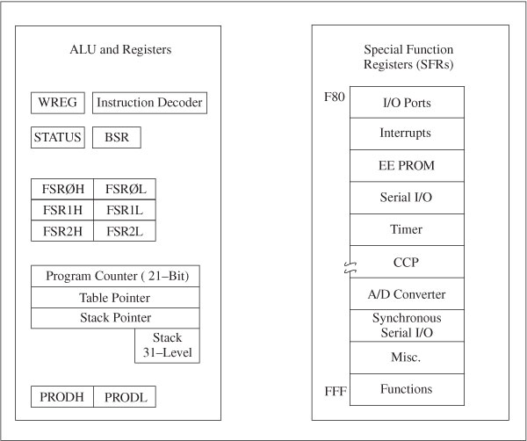
PIC18F Programming Model
The representation of the internal architecture of a microprocessor, necessary to write assembly language programs
Divided into two groups
  ALU Arithmetic Logic Unit (ALU)
  Special Function Registers (SFRs) from data memory

Slide 3
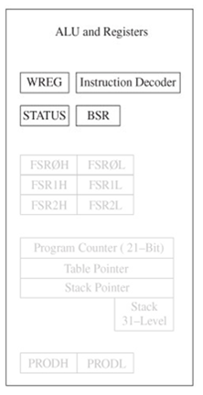
Registers
WREG
  8-bit Working Register (equivalent to an accumulator)
BSR: Bank Select Register
  4-bit Register (0 to F)
    Only low-order four bits are used to provide MSB four bits of a12-bit address of data memory.
STATUS: Flag Register

Slide 4
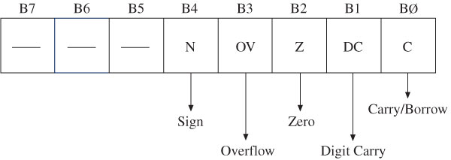
Flags in Status Register
Example: 9F+52 =F1
1001 1111
0101 0010
-------------
1111 0001
N=1,OV=0, Z=0, C=0, DC=1
C (Carry/Borrow Flag):
  set when an addition generates a carry and a subtraction generates a borrow
DC (Digit Carry Flag):
  also called Half Carry flag; set when carry generated from Bit3 to Bit4 in an arithmetic operation
Z (Zero Flag):
  set when result of an operation is zero
OV (Overflow Flag):
  set when result of an operation of signed numbers goes beyond seven bits
N (Negative Flag):
  set when bit B7 is one of the result of an arithmetic /logic operation

Slide 5
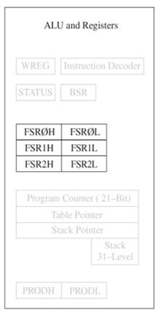
File Select Registers (FSR)
There are three registers:
    FSR0, FSR1, and FSR2
    Each register composed of two 8-bit registers (FSRH and FSRL)
Used as pointers for data registers
Holds 12-bit address of data register

Slide 6
Other Registers
Stack
  31 word-sized registers used for temporary storage of memory addresses during execution of a program
Special Function Registers (SFRs):
  Data registers associated with I/O ports, support devices, and processes of data transfer
Program Counter (PC)
  21-bit register functions as a pointer to program memory during program execution
Table Pointer
  21-bit register used as a memory pointer to copy bytes between program memory and data registers
Stack Pointer (SP)
  Register used to point to the stack

Slide 7
Introduction to PIC18 Instruction Set

Slide 8
PIC18 Instruction Set
Includes 77 instructions; 73 one word (16-bit) long and remaining four two words (32-bit) long
Divided into seven groups
  Move (Data Copy) and Load
  Arithmetic
  Logic
  Program Redirection (Branch/Jump)
  Bit Manipulation
  Table Read/Write
  Machine Control

Slide 9
movwf Instruction form
“Write contents of W register to data memory location floc”. General form:
  movwf floc[,a] ;floc←(w)
    floc is a memory location in the file registers (data memory)
    W is the working register
    a is data memory access bit, ‘ACCESS’(0) use Access Bank --ignore Bank Select Register (BSR), ‘BANKED’(1), use BSR. (will talk more about this later), [a] means optional usage.
When floc is destination, means “modify memory location floc”.
  movwf 0x70 ;0x70 ←(w) write W to location 0x70

Slide 10
movwf Instruction Execution
Assume the following Memory/Register contents before execution:
W = 0x2A
W = 0x2A (unaffected)
Location | Contents
0x06f | 0x34
0x070 | 0x8f
0x071 | 0x00
0x072 | 0xf9
Location | Contents
0x06f | 0x34
0x070 | 0x2A
0x071 | 0x00
0x072 | 0xf9
modified
BEFORE
movwf 0x070
AFTER
movwf 0x070

Slide 11
movwf Instruction Format
movwf floc [,a]
floc (w)
B₁₅ | B ₁₄ | B₁₃ | B₁₂ |  | B₁₁ | B₁₀ | B₉ | B₈ |  | B₇ | B₆ | B₅ | B₄ |  | B₃ | B₂ | B₁ | B₀
0 | 1 | 1 | 0 |  | 1 | 1 | 1 | a |  | f | f | f | f |  | f | f | f | f
‘ffff ffff’ lower 8-bit of floc address
a = 1 use Bank Select Register (BANKED);
a = 0 ignore BSR, just use (ACCESS - BANK)
machine code
movwf 0x070, 0 0110 1110 0111 0000 = 0x6e70
movwf 0x070, 1 0110 1111 0111 0000 = 0x6f70

Slide 12
The Bank Select Register again....
movwf 0x070, 1 also written as: movwf 0x070, BANKED
The execution of the above instruction depends on the value in the Bank Select Register.
If BSR = 0, then location 0x070 is modified.
If BSR = 1, then location 0x170 is modified.
If BSR = 2, then location 0x270 is modified....etc.
movwf 0x070, 0 also written as: movwf 0x070, ACCESS
The execution of the above instruction does NOT depend on the value in the Bank Select Register, only the 8 bits in the machine code is used for the address location.
Location 0x070 is always modified.

Slide 13
What the heck is the Access Bank?
The lower 128 locations (0x0 –0x07F) and upper 128 locations (0xF80 –0xFFF) as a group is called the Access Bank.
The ‘a’ bit (access bit) in the machine code can provide access to these locations without regard to the BSR. This is important because the SFRs live in 0xF80 –0xFFF (Bank 15).
If the ‘a’ bit was NOT included in instructions, then anytime we wanted to access a special function register (which happens a LOT), we would have to change the value of the BSR to 0xF (Bank 15).

Slide 14
Rules for the ‘access’ bit in instructions
We will use the following rules for the value of the ‘a’ (Access) bit in machine code produced for instructions that contain a data memory address (these assumptions used by the MPLAB® assembler)
a. If the data memory address is between 0x000 –0x07F or between 0xF80 –0xFFF, assume the ‘a’ bit is a ‘0’ (ignore the BSR).
b. If the data memory address is between 0x080 –0xF7F, assume the ‘a’ bit is a ‘1’ (use the BSR).
We will NEVER write: movf 0x070, BANKED
Always either “movf 0x070” (assume ACCESS, a = 0)
or “movf 0x170” (assume BANKED, a = 1).

Slide 15
Changing the Bank Select Register
movwf floc [,a]
floc (w)
B₁₅ | B ₁₄ | B₁₃ | B₁₂ |  | B₁₁ | B₁₀ | B₉ | B₈ |  | B₇ | B₆ | B₅ | B₄ |  | B₃ | B₂ | B₁ | B₀
0 | 1 | 1 | 0 |  | 1 | 1 | 1 | a |  | f | f | f | f |  | f | f | f | f
mnemonic |  | Machine code
movwf | 0x070 | 0110 1110 0111 0000 = 0x6e70 | (a=0)
movwf | 0x170 | 0110 1111 0111 0000 = 0x6f70 | (a=1)
movwf | 0x270 | 0110 1111 0111 0000 = 0x6f70 | (a=1)
movwf | 0xF90 | 0110 1111 1001 0000 = 0x6e90 | (a=0)
We will not specify the ‘a’ bit on instruction mnemonics.

Slide 16

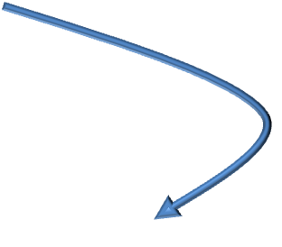
Machine code example for movwf
The instruction mnemonics are different, but the machine code is the same! That is because machine code only uses lower 8-bits of the address!!!
movwf 0x170
For this to work, BSR must be 0x1!
movwf 0x270
For this to work, BSR must be 0x2!
mnemonic |  | Machine code
movwf | 0x070 | 0110 1110 0111 0000 = 0x6e70 | (a=0)
movwf | 0x170 | 0110 1111 0111 0000 = 0x6f70 | (a=1)
movwf | 0x270 | 0110 1111 0111 0000 = 0x6f70 | (a=1)
movwf | 0xF90 | 0110 1110 1001 0000 = 0x6e90 | (a=0)
By default (after processor reset), BSR = 0x0 !!!!.

Slide 17

movlb Instruction
movlb k
BSR k
B₁₅ | B ₁₄ | B₁₃ | B₁₂ |  | B₁₁ | B₁₀ | B₉ | B₈ |  | B₇ | B₆ | B₅ | B₄ |  | B₃ | B₂ | B₁ | B₀
0 | 0 | 0 | 0 |  | 0 | 0 | 0 | 1 |  | 0 | 0 | 0 | 0 |  | k | k | k | k
Move 4-bit literal k into BSR (only 16 banks, hence 4-bits)
machine code
movlb 2 0000 0001 0000 0010= 0x0102
Example usage:
movlb 2
movwf 0x270
Selects bank 2
Causes the value stored in W to be written to location 0x270

Slide 18


movf Move Register
Copies a value from data memory to w or back to data memory.
movwf floc [,d[,a]
d (floc)
B₁₅ | B ₁₄ | B₁₃ | B₁₂ |  | B₁₁ | B₁₀ | B₉ | B₈ |  | B₇ | B₆ | B₅ | B₄ |  | B₃ | B₂ | B₁ | B₀
0 | 1 | 0 | 1 |  | 0 | 0 | d | a |  | f | f | f | f |  | f | f | f | f
‘ffff ffff’ lower 8-bit of floc address
‘d’ : 0 = w reg, 1 = f
The second example looks useless as it just moves the contents of a memory location back onto itself. However, it is useful, as will be seen later.
machine code
Instructions
0x501D movf 0x01D,w w [0x01D]
0x521D movf 0x01D,f [0x1D] [0x01D]

Slide 19
Copying Data Between Banks
Assume you want to copy data from location 0x1A0 to location 0x23F. Location 0x1A0 is in bank1, location 0x23F is in bank 2.
The HARD way:
movlb 0x1 ; select bank1
movf 0x1A0, w ; w [0x1A0]
movlb 0x2 ; select bank2
movwf 0x23F ; [0x23F] (w)
The EASY way:
movff 0x1A0, 0x23F ; [0x23f] [0x1A0]
The movff instruction copies the contents of a source location to a destination location

Slide 20
movff Instruction
movff f_{s}, f_{d}
[f_{d}] [f_{s}]
B₁₅ | B ₁₄ | B₁₃ | B₁₂ |  | B₁₁ | B₁₀ | B₉ | B₈ |  | B₇ | B₆ | B₅ | B₄ |  | B₃ | B₂ | B₁ | B₀
1 | 1 | 0 | 0 |  | f | f | f | f |  | f | f | f | f |  | f | f | f | f | (src)
1 | 1 | 1 | 1 |  | f | f | f | f |  | f | f | f | f |  | f | f | f | f | (dest)
Move contents of location f_{s} to location f_{d}
machine code
Instructions
0xC1A0 movff 0x1A0, 0x23F [0x23F] [0x01D]
0xF23F
Requires two instruction words (4 bytes). Only movff, goto, call, lfsr instructions take two words; all others take one word.

Slide 21
The addwf instruction
General form:
addwf floc [, d[, a] d←(floc)+ (w)
floc is a memory location in the file registers (data memory)
w is the working register
d is the destination, can either be the literal ‘f’(1, default) or ‘w’(0)
a is data memory access bit
addwf 0x070,w ;w ←(0x070) + (w)
addwf 0x070,f ;0x070 ←(0x070) + (w)

Slide 22

addwf Example
Location | Contents
0x058 | 0x2C
0x059 | 0xBA
0x05A | 0x34
0x05B | 0xD3
Assume Data memory contents on the right
w register contains 0x1D
ALWAYS specify these in your instructions!!!!!!!
Execute: addwf 0x059, w w ←[0x059] + (w)
w = (0x059) + (w) = 0xBA + 0x1D = 0xD7
After execution w = 0xD7, memory unchanged.
Execute: addwf 0x059, f [0x059] ←[0x059] + (w)
[0x059] = [0x059] + (w) = 0xBA + 0x1D = 0xD7
After execution, location 0x059 contains 0xD7, w is unchanged.

Slide 23
The subwf instruction
General form:
subwf floc [, d[, a] d←(floc) - (w)
floc is a memory location in the file registers (data memory)
w is the working register
d is the destination, can either be the literal ‘f’(1, default) or ‘w’(0)
a is data memory access bit
subwf 0x070,w ;w ←(0x070) - (w)
subwf 0x070,f ;0x070 ←(0x070) - (w)

Slide 24
subwf Example
Assume Data memory contents on the right
w register contains 0x1D
Location | Contents
0x058 | 0x2C
0x059 | 0xBA
0x05A | 0x34
0x05B | 0xD3
ALWAYS specify these in your instructions!!!!!!!
Execute: addwf 0x059, w w ←[0x059] - (w)
w = (0x059) + (w) = 0xBA + 0x1D = 0x9D
After execution w = 0x9D, memory unchanged.
Execute: addwf 0x059, f [0x059] ←[0x059] - (w)
[0x059] = [0x059] + (w) = 0xBA + 0x1D = 0x9D
After execution, location 0x059 contains 0x9D, w is unchanged.

Slide 25


summarizing few points so far!!
almost every instruction has two operands, source and destination:
op-code | source | destination
movwf addwf movlb etc…. | W register Memory location (floc) literal (immediate value) | W register Memory location (floc)
The memory location specified in the instructions (floc) is 8-bits only, so we need extra 4-bits from the BSR register.
The Data memory splitted into two parts:
BANKED; used for storing data during run time
ACCESS BANK; used when you need to access any SFR.

Slide 26
Remaining Instruction Set

Slide 27
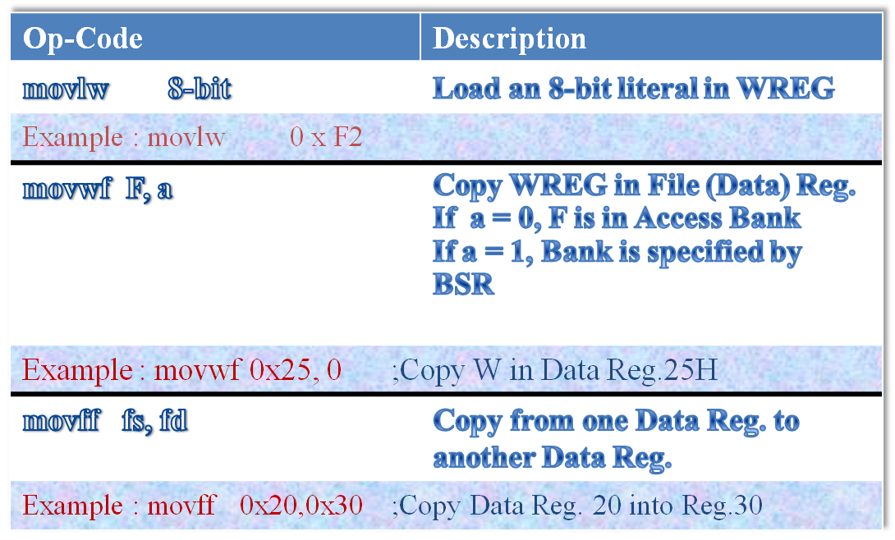
Move and Load Instructions

Slide 28
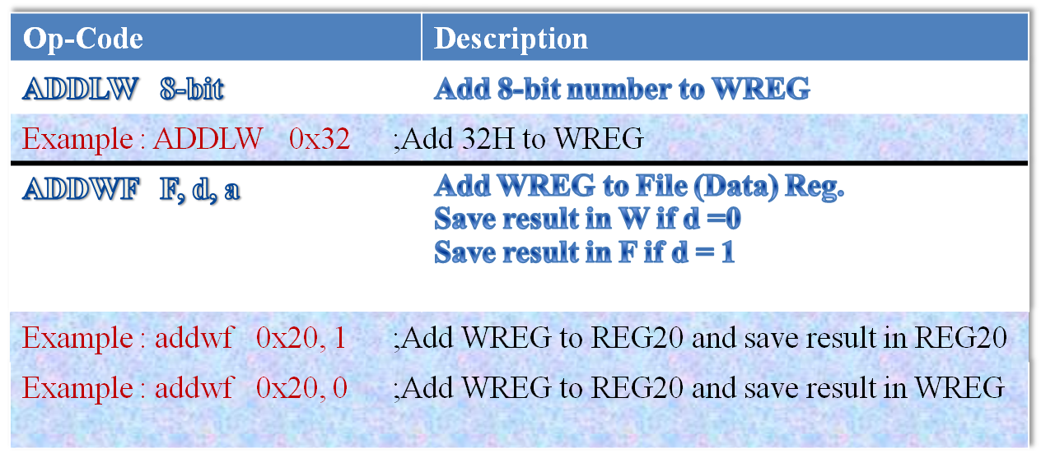
Arithmetic Instructions (1 of 3)

Slide 29
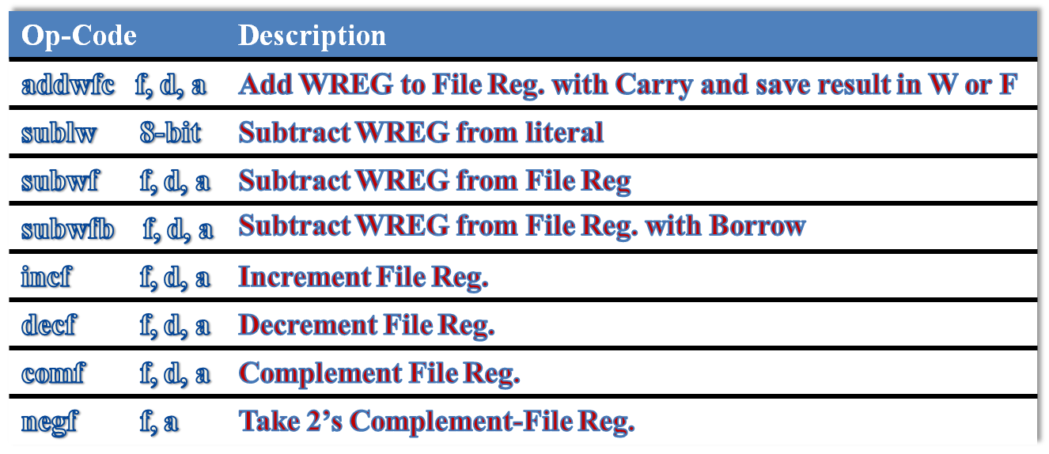
Arithmetic Instructions (2 of 3)

Slide 30
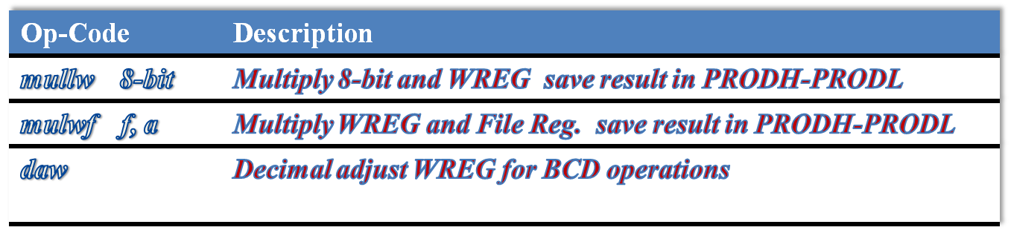
Arithmetic Instructions (3 of 3)

Slide 31
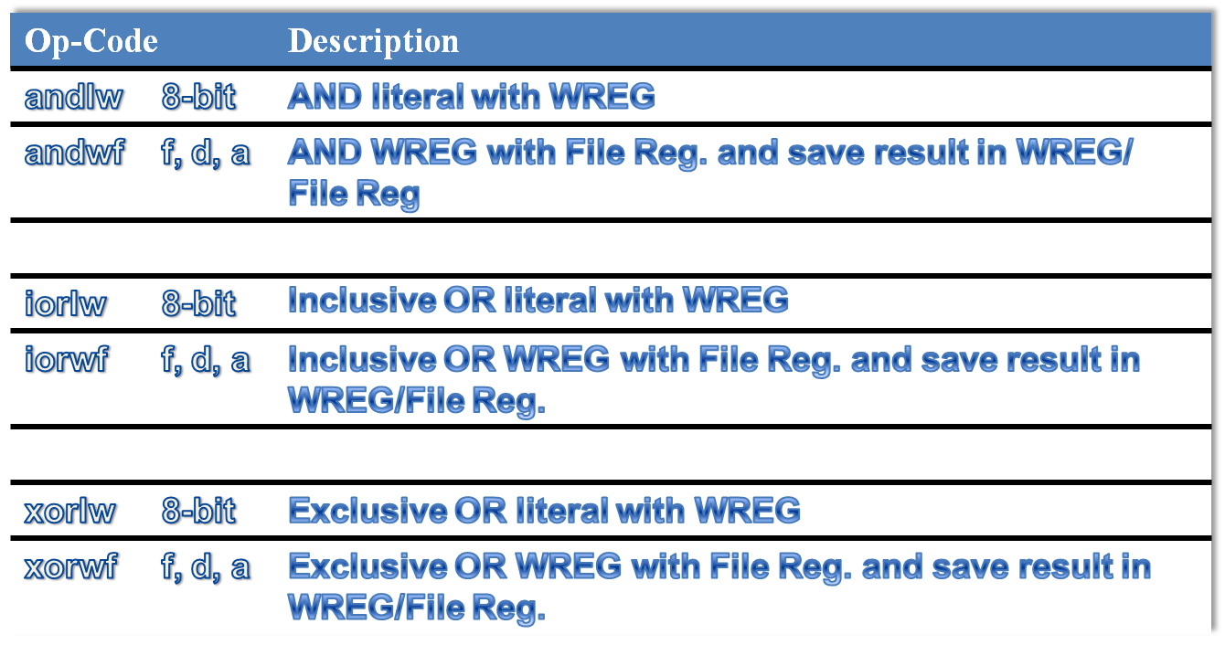
Logic Instructions

Slide 32
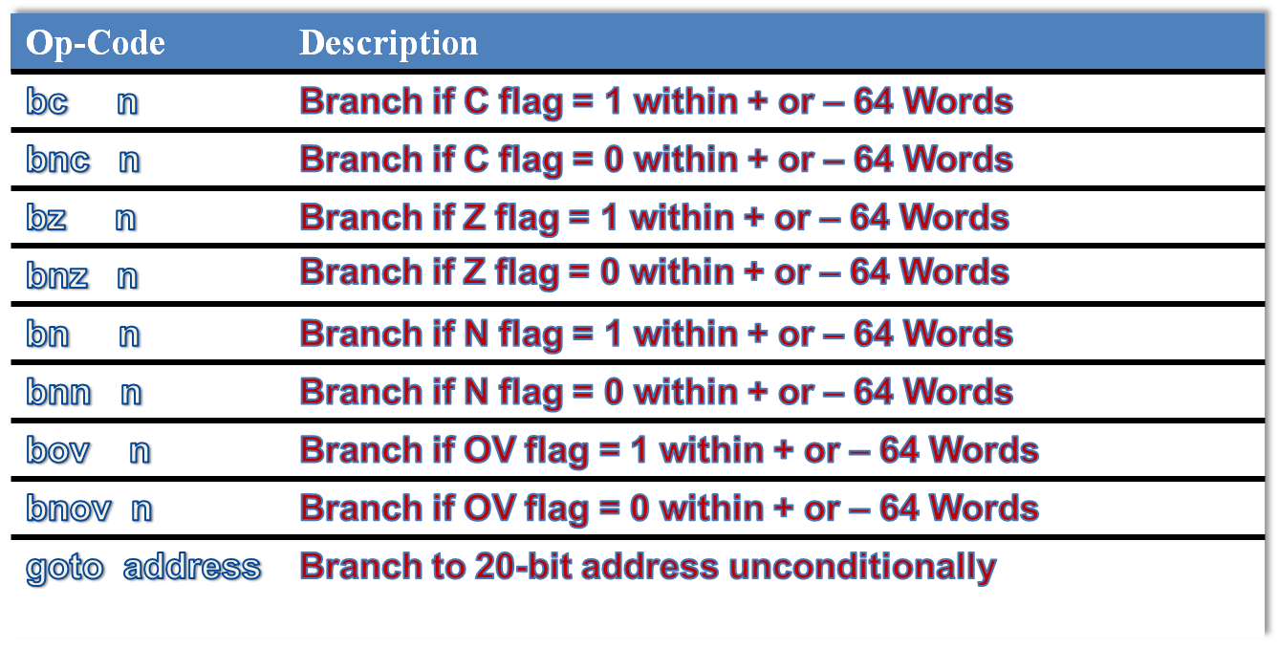
Branch Instructions

Slide 33
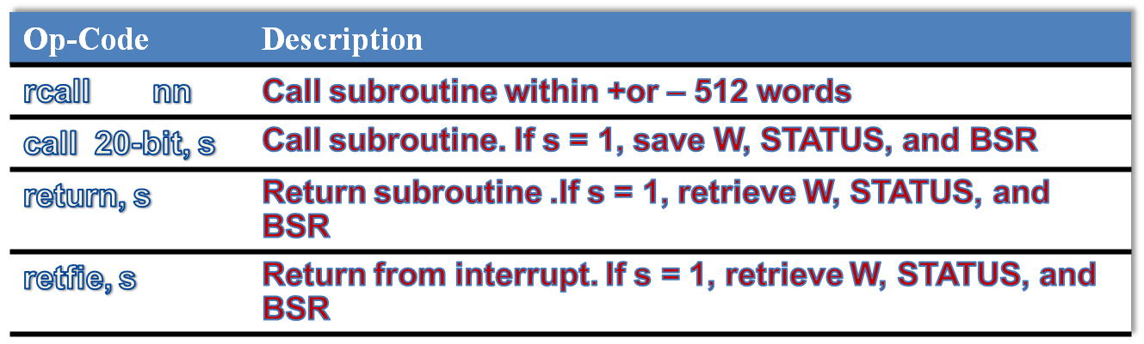
Call and Return Instructions

Slide 34
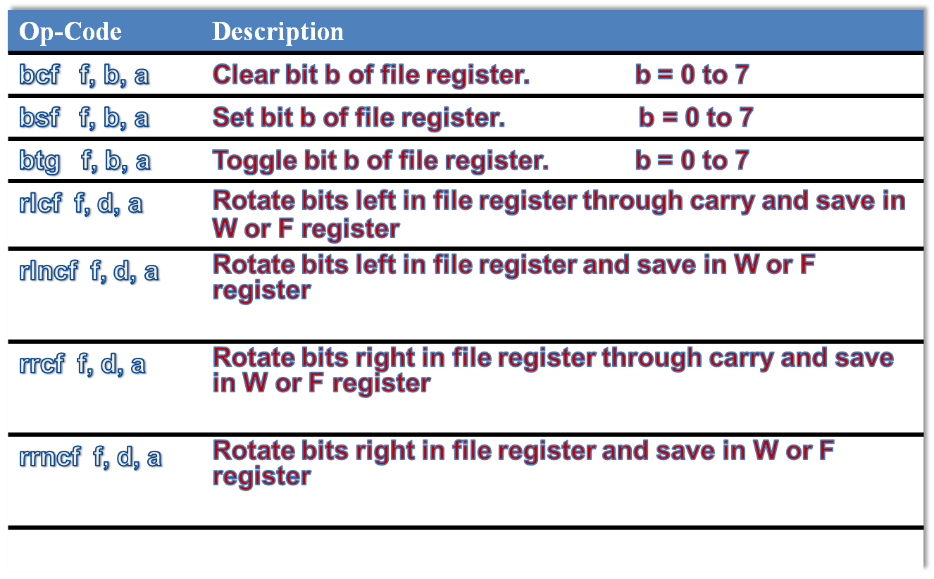
Bit Manipulation Instructions

Slide 35
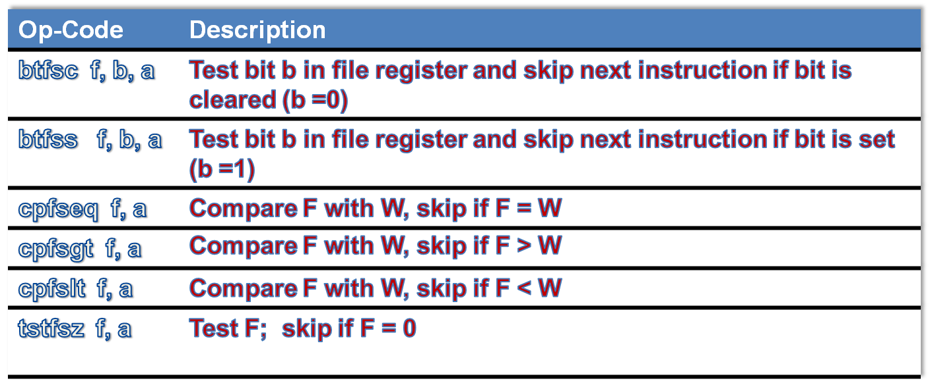
Test and Skip Instructions

Slide 36
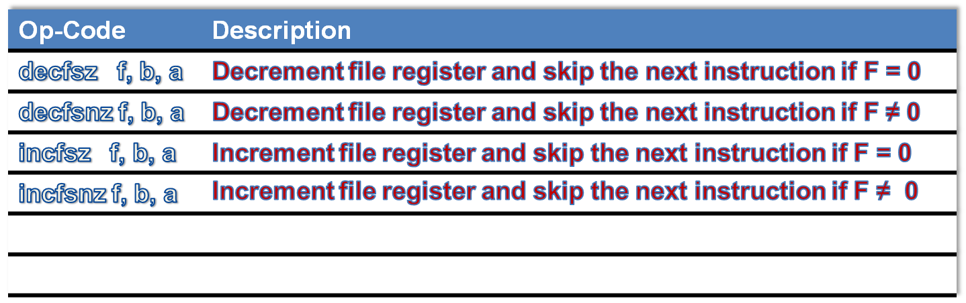
Increment/Decrement and Skip Next Instruction

Slide 37
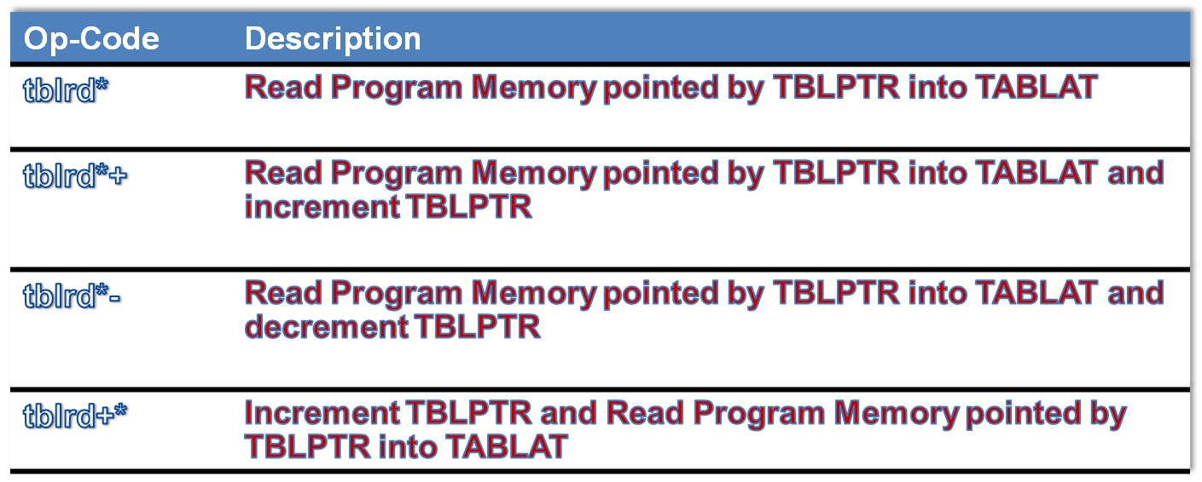
Table Read/Write Instructions (1 of 2)

Slide 38
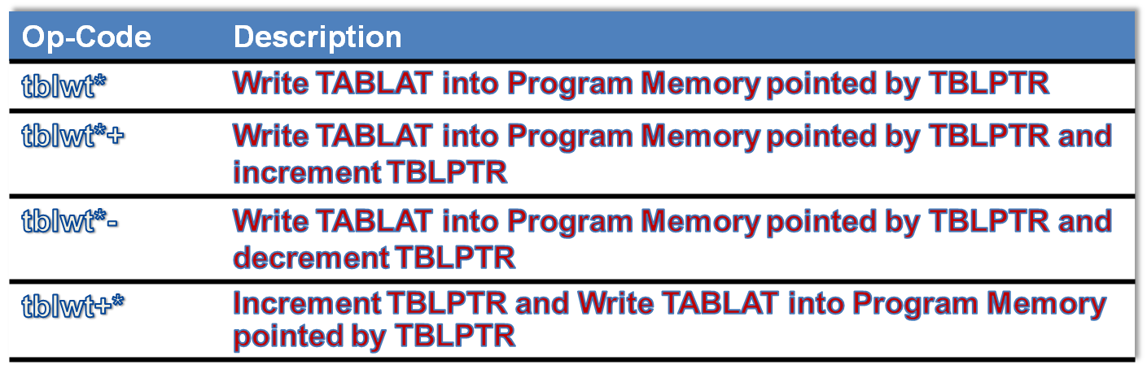
Table Read/Write Instructions (2 of 2)

Slide 39
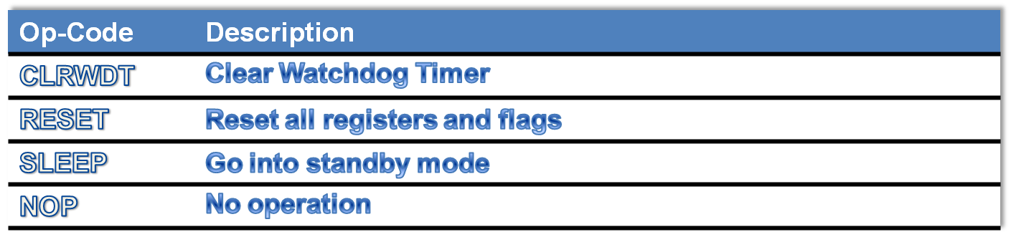
Machine Control Instructions

Slide 40
Writing Assembly Program
Byte order issues
Two conventions for ordering the bytes within a word
  Big Endian: the most significant byte of a variable is stored at the lowest address
  Little Endian: the least significant byte of a variable is stored at the lowest address
Ex: double word 87654321in memory
00003
00002
00001
00000
87
65
43
21
00003
00002
00001
00000
21
43
65
87
Little
Big

Slide 41

Writing Assembly Program
Examples
Example 1 Write a program that adds the three numbers stored in data registers at 0x20, 0x30, and 0x40 and places the sum in data register at 0x50.
Pseudo Algorithm:
Step 1
Load the number stored at 0x20 into the WREG register.
Step 2
Add the number stored at 0x30 and the number in the WREG register and
leave the sum in the WREG register.
Step 3
Add the number stored at 0x40 and the number in the WREG register and
leave the sum in the WREG register.
Step 4
Store the contents of the WREG register in the memory location at 0x50.

Slide 42
Writing Assembly Program
The program that implements this algorithm is as follows:
#include <p18F8720.inc> ; can be other processor
org 0x00
goto start
org 0x08
retfie
org 0x18
retfie
start movf 0x20,W,A ; WREG ← [0x20]
addwf 0x30,W,A ; WREG ← [0x20] + [0x30]
addwf 0x40,W,A ; WREG ← [0x20] + [0x30] + [0x40]
movwf 0x50,A ; 0x50 ← sum (in WREG)
end

Slide 43
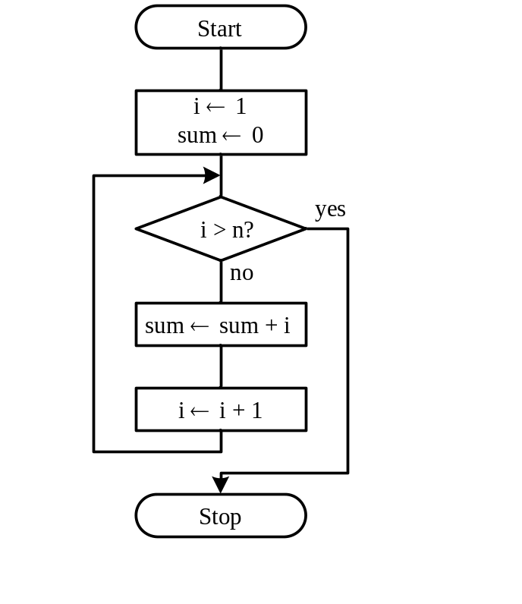
Writing Assembly Program
Examples
Example 2 Write a program to compute 1 + 2 + 3 + … + n and save the sum at 0x00 and 0x01.
Program Logic:

Slide 44
Writing Assembly Program
Program of Example 2 (in for i = n1 to n2 construct)
#include <p18F8720.inc>
radix dec
n equ D'50'
sum_hi set 0x01 ; high byte of sum
sum_lo set 0x00 ; low byte of sum
i set 0x02 ; loop index i
org 0x00 ; reset vector
goto start
org 0x08
retfie
org 0x18
retfie
start clrf sum_hi,A ; initialize sum to 0
clrf sum_lo,A ; "
clrf i,A ; initialize i to 0
incf i,F,A ; i starts from 1
sum_lp movlw n ; place n in WREG
cpfsgt i,A ; compare i with n and skip if i > n
bra add_lp ; perform addition when i ≤ 50
bra exit_sum ; it is done when i > 50

Slide 45
Writing Assembly Program
add_lp movf i,W,A ; place i in WREG
addwf sum_lo,F,A ; add i to sum_lo
movlw 0
addwfc sum_hi,F,A ; add carry to sum_hi
incf i,F,A ; increment loop index i by 1
bra sum_lp
exit_sum nop
end

Slide 46
How It Works…. example and illustration

Slide 47
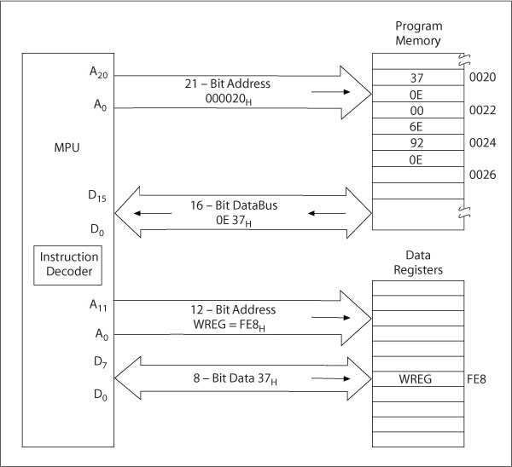
Bus Contents During the Execution of Instruction
Execution of MOVLW 0x37 instruction
machine code
0x0E37

Slide 48
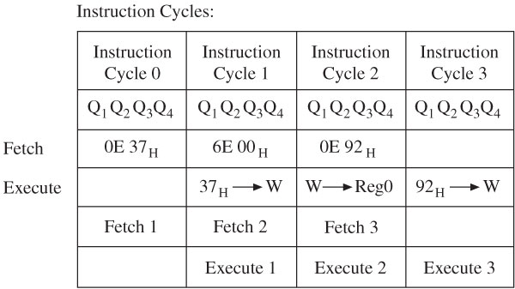
Pipeline Fetch and Execution

Slide 49
Clock Cycles vs. Instruction Cycles
The clock signal used by a PIC18 μC to control instruction execution can be generated by an off-chip oscillator (with a maximum clock frequency of 40 MHz).
A PIC18 instruction takes 1 or 2 instruction cycles, depending on the instruction (see Table 20-2, PIC18Fxx2 data sheet).
If an instruction causes the program counter to change, that instruction takes 2 instruction cycles. An add instruction takes 1 instruction cycle. How much time is this if the clock frequency is 20 MHz ?
1/frequency = period, 1/20 MHz = 50 ns
Add instruction @ 20 MHz takes 4 * 50 ns = 200 ns (or 0.2 us).
By comparison, a Pentium IV add instruction @ 3 GHz takes 0.33 ns (330 ps). A Pentium IV could emulate a PIC18Fxx2 faster than a PIC18Fxx2 can execute! But you can’t put a Pentium IV in a toaster, or buy one from Digi-Jeyfor $5.00.

